Slide 1
ISTQB® Certified Tester – Testing with Generative AI (CT-GenAI) Chapter 4

Slide 2
Chapter 4 - LLM-Powered Test Infrastructure for Software Testing
4.1 Architectural Approaches for LLM-Powered Test Infrastructure
GenAI-4.1.1 (K2) Explain key architectural components and concepts of LLM-powered test infrastructure
GenAI-4.1.2 (K2) Summarize Retrieval-Augmented Generation
HO-4.1.2 (H1) Experiment with Retrieval-Augmented Generation for a given test task
GenAI-4.1.3 (K2) Explain the role and application of LLM-powered agents in automating test processes
HO-4.1.3 (H0) Observe how an LLM-powered agent assists in automating a repetitive test task
4.2 Fine-Tuning and LLMOps: Operationalizing Generative AI for Software Testing
GenAI-4.2.1 (K2) Explain the fine-tuning of language models for specific test tasks
HO-4.2.1 (H0) Observe an example of a fine-tuning process for a given test task and language model
GenAI-4.2.2 (K2) Explain LLMOps and its role in deploying and managing LLMs for test tasks.

Slide 3
Chapter 4 - LLM-Powered Test Infrastructure for Software Testing
4.1 Architectural Approaches for LLM-Powered Test Infrastructure
Core Types
AI Chatbots – Support testers through interactive guidance and automated responses
LLM-Powered Test Tools – Assist in generating, executing, and analyzing test cases
Extended Architectures
Basic LLM Infrastructure – Foundation for integrating large language models into testing workflows
Retrieval Augmented Generation (RAG) – Enhances accuracy by combining LLM outputs with domain-specific knowledge sources
LLM-Powered Agent Architectures – Enable autonomous, multi-step test activities with reasoning and task orchestration.

Slide 4
Chapter 4 - LLM-Powered Test Infrastructure for Software Testing
4.1.1 Key Architectural Components and Concepts of LLM-Powered Test Infrastructure
GenAI-4.1.1 (K2) Explain key architectural components and concepts of LLM-powered test infrastructure.

Slide 5
Chapter 4 - LLM-Powered Test Infrastructure for Software Testing
4.1.1 Key Architectural Components and Concepts of LLM-Powered Test Infrastructure
Introduction to LLM-Powered Test Infrastructure
A system that integrates Large Language Models (LLMs) into the testing lifecycle to enhance automation, reasoning, and decision-making.
Unlike traditional AI Chatbots which are focused on conversational flow and generic interaction. LLM-Powered Test Tools are built to process test queries, analyze complex requirements, and evaluate software outputs.
Key Capabilities of LLM-Powered Test Tools:
Requirement analysis and refinement
Dynamic generation of testware
Intelligent evaluation of test execution results.

Slide 6
Chapter 4 - LLM-Powered Test Infrastructure for Software Testing
4.1.1 Key Architectural Components and Concepts of LLM-Powered Test Infrastructure
High-Level Architecture of LLM-Powered Test Infrastructure
To ensure security, efficiency, and accuracy, the architecture of LLM-Powered Test Infrastructure moves beyond a simple request-response model into a structured three-tier system:
Front-End (User Interface)
UI where testers input commands, requirements, or natural language queries.
Back-End (Processing Hub)
The "engine room" that handles authentication, data retrieval, and prompt orchestration.
The LLM Layer
The intelligence core which is either a third-party service (API-based) or a secure, custom in-house model.

Slide 7
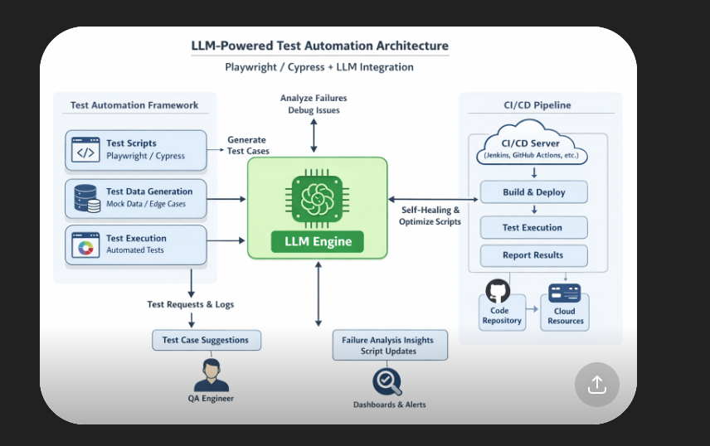
Chapter 4 - LLM-Powered Test Infrastructure for Software Testing

Slide 8
Chapter 4 - LLM-Powered Test Infrastructure for Software Testing
4.1.1 Key Architectural Components and Concepts of LLM-Powered Test Infrastructure
Evolution of LLM Powered Test Infra
This LLM-Powered test infrastructure architecture disrupts the traditional client-server model by introducing Intelligent Processing:
Reasoning vs. Serving
The LLM doesn’t just "serve" data; it interprets and reasons based on specific test products (code, logs, user stories).
This means an LLM is not just a data provider, but a thinking system.
Serving (basic systems) → Just returns stored or predefined answers → Like: “Here is the result”
Reasoning (LLM) → Understands context and analyzes inputs like:
test cases
logs
code
user stories
Then it figures out insights, not just data.

Slide 9
Chapter 4 - LLM-Powered Test Infrastructure for Software Testing
Rule Based Chat Bots vs. LLM-powered Test Infrastructure
Unlike rule-based chatbots which follow rigid scripts
LLM infrastructure generates test insights dynamically from context, such as requirements, code, or test results.
Rule-Based Chatbots
These are simple systems that follow fixed rules.
Work using if–else conditions
Give predefined responses
Cannot understand new or complex situations
Example:
Input: “Login test failed”
Output: “Please check your credentials”
It doesn’t actually analyze the problem — it just follows a script.

Slide 10
Chapter 4 - LLM-Powered Test Infrastructure for Software Testing
Rule Based Chat Bots vs. LLM-powered Test Infrastructure
Unlike rule-based chatbots which follow rigid scripts
LLM infrastructure generates test insights dynamically from context, such as requirements, code, or test results.
LLM-Powered Test Infrastructure
This uses AI models like ChatGPT to understand, analyze, and generate insights dynamically.
Understands context (logs, code, requirements)
Can reason and explain failures
Generates new test cases and fixes
Adapts to different scenarios
Example:
Input: “Login test failed” + logs
Output: → “Failure due to API timeout. Suggest increasing wait time or mocking API response.”
It actually analyzes and explains the root cause

Slide 11
Chapter 4 - LLM-Powered Test Infrastructure for Software Testing
4.1.1 Key Architectural Components and Concepts of LLM-Powered Test Infrastructure
Data Integration & The Modern Back-End
The back-end is no longer just a bridge it is a sophisticated integrator of diverse data types:
Relational Databases
Handles structured data in form of tables
Vector Databases
This is the key to modern AI testing. These store "embeddings" to allow for semantic retrieval, finding relevant test information based on meaning rather than just keywords.
What they store:
“Embeddings” (numerical representations of text)
Instead of storing just words, they store meaning
Simple explanation:
Normal search → finds exact keywords
Vector search → finds similar meaning

Slide 12
Chapter 4 - LLM-Powered Test Infrastructure for Software Testing
4.1.2 Retrieval-Augmented Generation
RAG is a framework that enhances LLMs by integrating external data sources into their response generation process which increases the relevance and accuracy of the LLM output.
Standard LLMs are frozen in time (based on their training data). RAG allows the model to "look up" your latest project files before answering.
The goal is to increase the relevance and accuracy of AI-generated test artifacts.

Slide 13
Chapter 4 - LLM-Powered Test Infrastructure for Software Testing
4.1.2 Retrieval-Augmented Generation
How RAG Processes a Test Query
When a tester submits a prompt (e.g., "Generate test cases for the login module"), the system follows a two-step execution:
Retrieval Step
The system encodes the user’s query into a vector.
It searches the vector database for chunks with the highest semantic similarity to the prompt.
Generation Step
The retrieved "context chunks" are fed into the LLM along with the original prompt.
The LLM synthesizes a response that combines its general linguistic ability with the specific data retrieved.

Slide 14
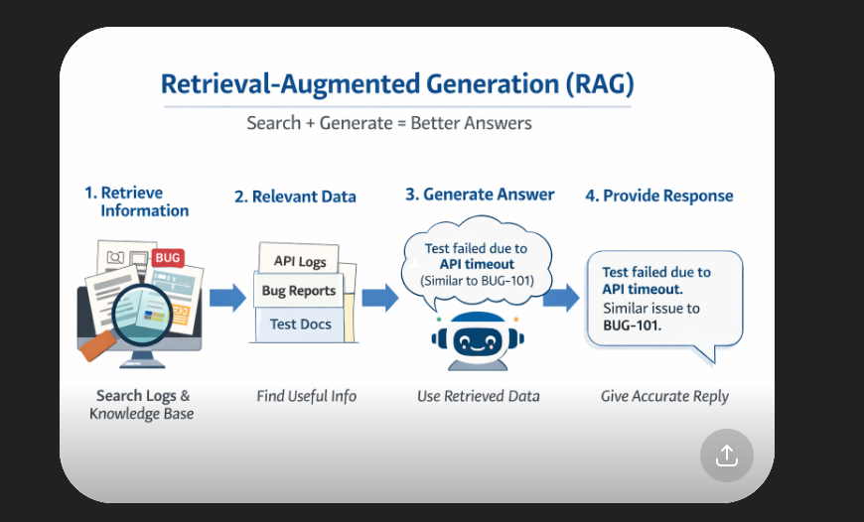
Chapter 4 - LLM-Powered Test Infrastructure for Software Testing

Slide 15
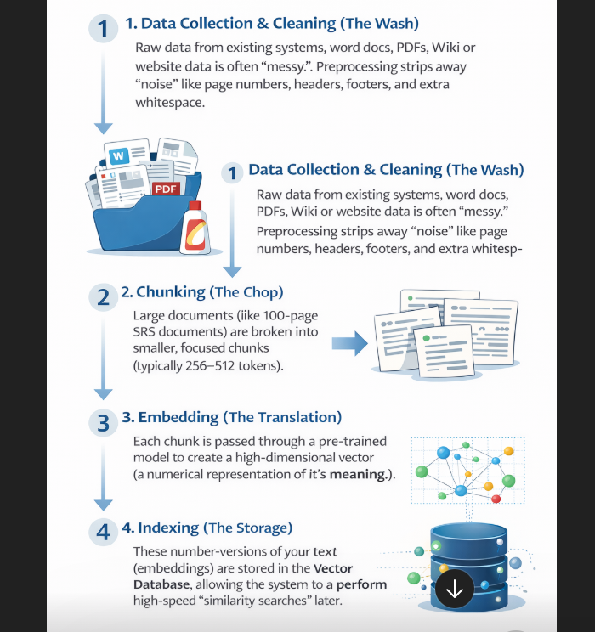
Chapter 4 - LLM-Powered Test Infrastructure for Software Testing
4.1.2 Retrieval-Augmented Generation
Key Steps in RAG Preprocessing Pipeline

Slide 16
Chapter 4 - LLM-Powered Test Infrastructure for Software Testing
4.1.2 Retrieval-Augmented Generation
Relevant Response from RAG
The output generated by the are relevant, accurate and contextually appropriate.
Response is based on the model's pre-existing training and data pertinent to the prompt.

Slide 17
Chapter 4 - LLM-Powered Test Infrastructure for Software Testing
4.1.2 Retrieval-Augmented Generation
RAG Applications in the Testing Lifecycle
RAG transforms how we handle internal company data such as databases, documentation, and repositories.
In Test Analysis, RAG automatically aligns test objectives with the latest updated specifications.
In Test Designing, it ensures generated test cases reflect current business logic found in internal documentation.
RAG can access real-time data from repositories to ensure test tasks never fall behind the latest code commit or requirement change.

Slide 18
Chapter 4 - LLM-Powered Test Infrastructure for Software Testing
4.1.3 The Role of LLM-Powered Agents in Automating Test Processes
Introduction to LLM-Powered Agents
Specialized GenAI applications powered by LLMs and designed for semi-autonomous or autonomous processing of defined tasks.
Key Capabilities of LLM-Powered Agents:
Natural Language Understanding (Interprets complex test instructions)
Reasoning (Breaks down high-level goals into executable steps)
Actionable Intelligence (Not just generating text, but taking "intelligent actions" within the test ecosystem)
Core Difference: While a chatbot responds, an LLM agent acts.

Slide 19
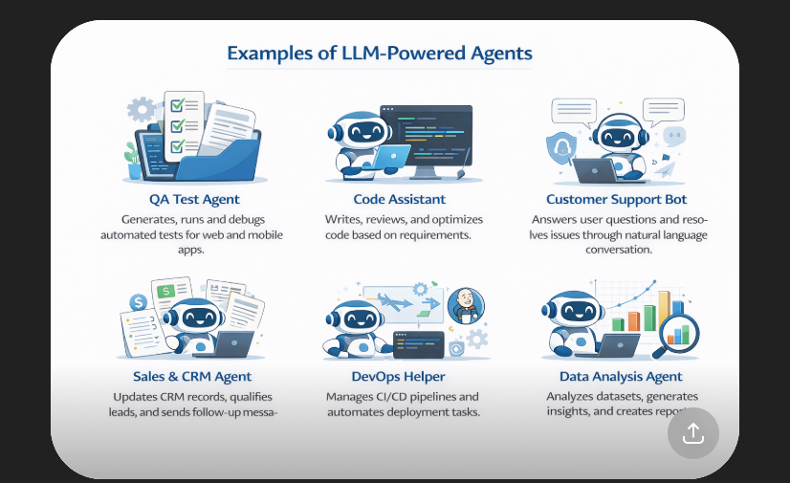
Chapter 4 - LLM-Powered Test Infrastructure for Software Testing

Slide 20
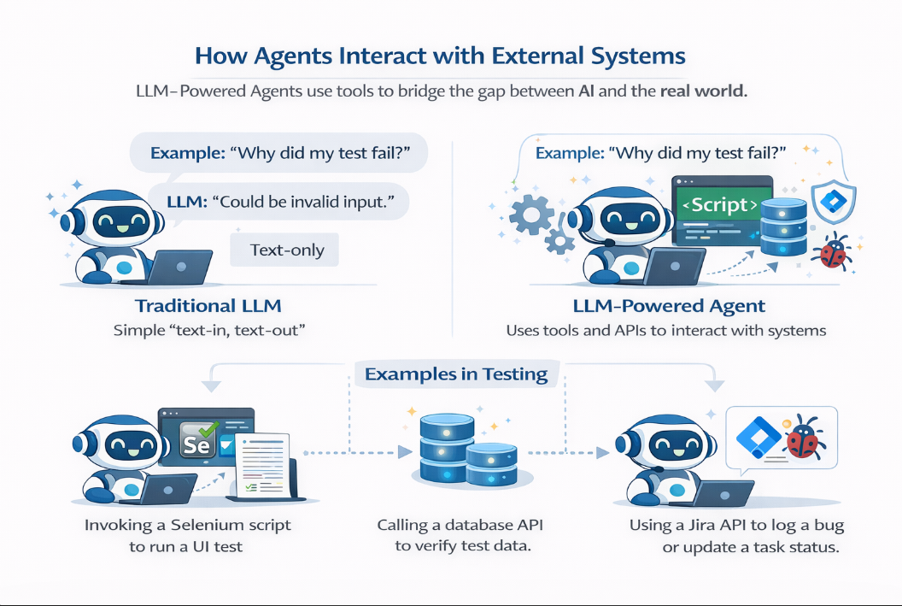
Chapter 4 - LLM-Powered Test Infrastructure for Software Testing
4.1.3 The Role of LLM-Powered Agents in Automating Test Processes

Slide 21
Chapter 4 - LLM-Powered Test Infrastructure for Software Testing
4.1.3 The Role of LLM-Powered Agents in Automating Test Processes
Degree of Autonomy in LLM-Powered Agents
LLM-Powered Agents can be categorized based on how much human intervention they require:
Autonomous Agents
Operate independently using predefined rules, reinforcement learning, and adaptive feedback loops. They require minimal human intervention.
Semi-Autonomous
Perform tasks with periodic human oversight. Testers review outputs to ensure the output meets user-defined goals.
Multi-Agent Systems
Multi-agent architectures involve a collaborative system where several agents, each with specialized roles, communicate and coordinate to solve complex problems more efficiently than a single agent.
This coordinated effort among multiple AI agents is known as orchestration.

Slide 22
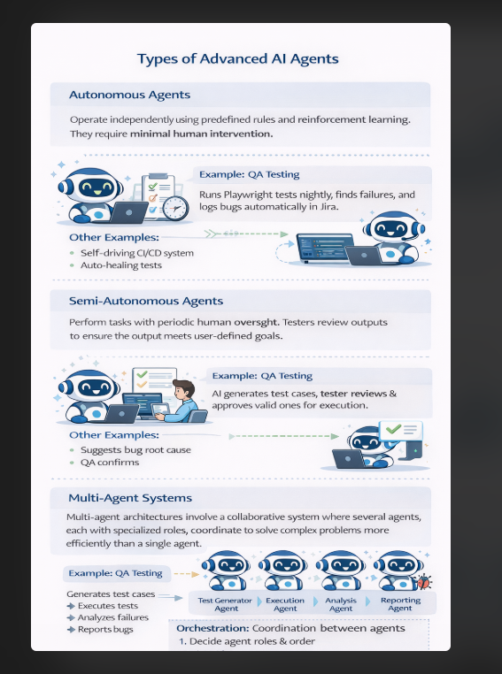
Chapter 4 - LLM-Powered Test Infrastructure for Software Testing

Slide 23
Chapter 4 - LLM-Powered Test Infrastructure for Software Testing
4.1.3 The Role of LLM-Powered Agents in Automating Test Processes
Risks in Agent-Driven Testing
Despite the power of LLM-Powered Agents, they inherit the fundamental limitations of the underlying LLM:
Hallucinations – Agents may "make up" test results, non-existent UI elements, or false bug reports.
Reasoning Errors – Logic gaps can lead the agent to follow an incorrect testing path or miss critical edge cases.
Biases – Pre-existing biases in training data may cause the agent to overlook certain user demographics or use-cases.
Impact – These errors weaken the reliability of the automated test process and can lead to "False Pass" results.

Slide 24
Chapter 4 - LLM-Powered Test Infrastructure for Software Testing
4.1.3 The Role of LLM-Powered Agents in Automating Test Processes
Risk Mitigation Strategies for LLM-Powered Agents
Few mitigation strategies for these risks are:
Automated Verification – Implement secondary "verification procedures" (non-AI scripts or rules) to cross-check the agent's results.
Semi-Autonomous Deployment – For high-risk or critical test tasks, maintain a "human-in-the-loop" model to validate AI decisions.
Result Grounding – Using RAG (Retrieval-Augmented Generation) to ensure agents act based on real specifications rather than purely internal weights.

Slide 25
Chapter 4 - LLM-Powered Test Infrastructure for Software Testing
4.2 Fine-Tuning and LLMOps: Operationalizing Generative AI for Software Testing
GenAI-4.2.1 (K2) Explain the fine-tuning of language models for specific test tasks.
HO-4.2.1 (H0) Observe an example of a fine-tuning process for a given test task and language model.
GenAI-4.2.2 (K2) Explain LLMOps and its role in deploying and managing LLMs for test tasks.

Slide 26
Chapter 4 - LLM-Powered Test Infrastructure for Software Testing
4.2 Fine-Tuning and LLMOps: Operationalizing Generative AI for Software Testing
Two key practices for operationalizing LLM-powered test infrastructure for testing include:
Fine-tuning LLMs
Managing the operational pipeline through LLMOps (Mailach 2024).

Slide 27
Chapter 4 - LLM-Powered Test Infrastructure for Software Testing
4.2.1 Fine-Tuning LLMs for Test tasks
GenAI-4.2.1 (K2) Explain the fine-tuning of language models for specific test tasks.
HO-4.2.1 (H0) Observe an example of a fine-tuning process for a given test task and language model.

Slide 28
Chapter 4 - LLM-Powered Test Infrastructure for Software Testing
4.2.1 Fine-Tuning LLMs for Test tasks
What is Fine-tuning?
Fine-tuning is the process of adapting a pre-trained model (LLM or SLM) to specific tasks or domains by further training it on a targeted, high-quality dataset.
Fine-tuning involves further training the model on a targeted dataset, allowing it to learn domain-specific knowledge and nuances.
By fine-tuning, the model's performance is enhanced for specialized applications, making it more accurate and relevant to the intended use case.
The choice of Model for Fine-tuning:
LLMs (Large Language Models) have high reasoning power, but are resource-intensive.
SLMs (Small Language Models) are efficiency-focused. By fine-tuning an SLM you can achieve high performance for specific tasks with much lower computational overhead.

Slide 29
Chapter 4 - LLM-Powered Test Infrastructure for Software Testing
4.2.1 Fine-Tuning LLMs for Test tasks
Practical Application (Test Case Engine)
Fine-tuning the GenAI model can automatically generate test cases from User Stories in the organization-specific format.
Fine-tuning process
a. Train the model on the company's historical User Stories and their corresponding "perfect" test cases.
b. The model learns the specific terminology and test process unique to that team.
After fine-tuning, the GenAI model no longer produces generic tests. It produces test cases that mirror the style, logic, and output format in line with the organization's format and standards.

Slide 30
Chapter 4 - LLM-Powered Test Infrastructure for Software Testing
4.2.1 Fine-Tuning LLMs for Test tasks
Challenges in Fine-Tuning for Testing
Fine-tuning introduces specific engineering challenges that must be managed:
Data Quality (Garbage In, Garbage Out) – To avoid biased or inaccurate results, the training dataset must be high-quality, task-specific, and representative of the actual software environment.
The Overfitting Trap – When a model becomes too specialized to the training data, it loses its "generalization" ability and might fail when it encounters a new, slightly different feature or scenario.
Model Opacity – A lack of transparency in reasoning makes it hard for testers to validate why a specific test case was generated, complicating the debugging of the AI's logic.
Resource Constraints – Fine-tuning large models requires significant GPU/TPU power, making the strategy for choosing between SLMs and LLMs critical for budget management.

Slide 31
Chapter 4 - LLM-Powered Test Infrastructure for Software Testing
4.2.1 Fine-Tuning LLMs for Test tasks
Managing Fine-Tuning Challenges
Preventing Overfitting
Use validation datasets (unseen data) during training to ensure the model still performs well on new scenarios.
Addressing Opacity
Implement Human-in-the-Loop reviews where senior testers audit the model's reasoning during the pilot phase.
Dataset Auditing
Regularly scan training data for bias to ensure the generated tests don't ignore specific user paths or edge cases.

Slide 32
Chapter 4 - LLM-Powered Test Infrastructure for Software Testing
4.2.2 LLMOps when Deploying and Managing LLMs for Software Testing
Introduction to LLMOps
LLMOps, or Large Language Model Operations, refers to a structured set of practices, tools, and processes designed to streamline the development, deployment, and long-term maintenance of LLMs in production.
Why it matters for Testing:
Predictability – Moving away from "random" AI behavior to reliable test results.
Automation – Integrating LLMs into CI/CD pipelines.
Governance – Ensuring the AI remains compliant with organizational standards over time.
The goal is to move from experimental scripts to a robust, scalable LLM-powered test infrastructure.

Slide 33
Chapter 4 - LLM-Powered Test Infrastructure for Software Testing
4.2.2 LLMOps when Deploying and Managing LLMs for Software Testing
How LLMOps decisions are Influenced?
The use of generative AI in an organization's test processes can be accomplished in a few different ways, which will influence the LLMOps decisions to be made.
Here are three possible approaches:
Using an AI Chatbot
Using a test tool with generative AI capabilities
In-house development of a test tool based on generative AI.

Slide 34
Chapter 4 - LLM-Powered Test Infrastructure for Software Testing
4.2.2 LLMOps when Deploying and Managing LLMs for Software Testing
Using an AI Chatbot
The primary considerations for this approach include managing data privacy and security risks while optimizing cost.
Organizations might use LLM-as-a-Service platforms if the necessary assurances are given or deploy in-house infrastructure using open-source licensed LLMs for greater control.
Key LLMOps Decisions:
Data Privacy – Rigorous assessment of how "prompts" are used (ensuring they aren't used for public training).
Cost Optimization – Managing token usage and subscription tiers.
Security – Preventing sensitive test data (PII or proprietary logic) from leaking to external vendors.

Slide 35
Chapter 4 - LLM-Powered Test Infrastructure for Software Testing
4.2.2 LLMOps when Deploying and Managing LLMs for Software Testing
Using a test tool with generative AI capabilities
This approach involves using established testing tools that have built-in Generative AI features.
This approach has similar considerations to AI chatbots, such as data privacy, security, and operational costs.
Operational Considerations:
Deep-diving into the security and performance assurances provided by the tool provider.
Evaluating how the AI features complement or disrupt existing manual and automated workflows.
Strategic Requirements:
Cost-Benefit Analysis should be done to check if the AI feature justifies the additional license cost.
Risk Assessment of the cloud or on-prem offering to choose the best option as per organizational needs.

Slide 36
Chapter 4 - LLM-Powered Test Infrastructure for Software Testing
4.2.2 LLMOps when Deploying and Managing LLMs for Software Testing
In-house development of a test tool based on generative AI
For organizations with high security requirements or unique domains, building a proprietary test tool is the most robust path.
It gives total ownership of data privacy, security protocols, and model behaviour.
Careful planning should be done for:
Compute Resources – Planning for GPU/cloud costs for hosting and inference.
Staff Expertise – Need for specialized skills in LLM infrastructure and deployment.
Validation & Maintenance – Establishing "structured processes" to validate that the custom tool's reasoning remains accurate as the software evolves.
Developing in-house solutions requires expertise in implementing and deploying an LLM-powered test infrastructure.

Slide 37
Chapter 4 - LLM-Powered Test Infrastructure for Software Testing
4.2.2 LLMOps when Deploying and Managing LLMs for Software Testing
Approaches for using LLMs in Organizations
These approaches are not mutually exclusive; organizations might:
Use Chatbots for high-level test strategy brainstorming.
Use test tools with generative AI capabilities for standard UI/API automation.
Also build custom agents for proprietary, high-security legacy systems.
Incorporate additional technologies (to enhance the effectiveness and adaptability of the test processes with GenAI):
Enhancing these tools using RAG for real-time requirement alignment.
Fine-tuning specific LLMs/SLMs to master the organization's unique domain vocabulary.

Slide 38
Thank You

